Slide 1



Human-in-the-loop Optimization of Shared Autonomy in Assistive Robotics
Deepak Gopinath, Siddarth Jain and
Brenna D. Argall
Notes:
Hi everyone. I am Deepak Gopinath and I am here from Northwestern University in Chicago and I will be talking about “title”, work that I did in collaboration with Siddarth Jain and Dr. Brenna Argall.

Slide 2
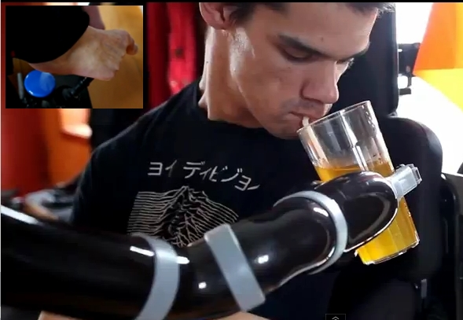
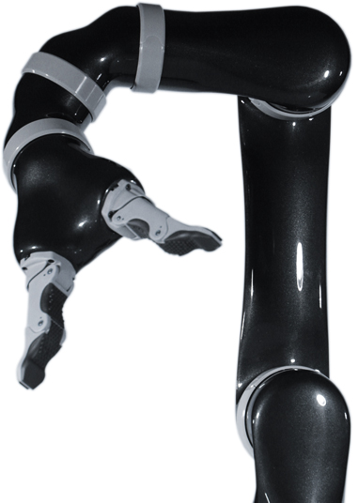

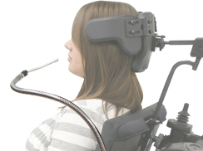
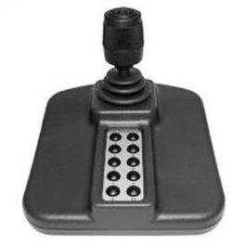
Shared control in assistive robotics
Robotic technologies for motor impaired subjects
Challenges in assistive robotics
  High dimensionality (machine complexity)
  Limited control interfaces (low-dimensional, discrete)
6 DOF
2D, discrete
1D, discrete
2-3D,
continuous
Notes:
The field of assistive and rehabilitation robotics aims to build robotic technologies for people who suffer from motor impairments as a result of spinal cord injuries or brain injuries. The goal is that these technologies will help them become more independent and reduce their dependence on caretakers. It also will enable to perform activities of daily lives in a more effective way thereby improving their quality of life. However, there are many challenges that makes the use of assistive robotics relatively hard. For example, here we have a 6DOF robotic manipulator. That is, in order to have complete control of the end effector a user should be able to control 6 dimensions simultaneously.. Due to the high dimensionality and complexity, manual control of these machines therefore become much harder. On the hand, the interfaces that are typically used for controlling assistive robots (joystick, headarray and sip n'puff) produce low dimensional and discrete signals resulting in increased cognitive and physical burden on the user. Shared control hopes to alleviate and address these issues by letting the system take responsibility to some extent, thereby reducing the human effort in achieving a goal.

Slide 3
Customization in shared control systems
Predefined control strategies need not work
User and task variability
Is there an optimal level of assistance?
Full Teleoperation
Optimal
Assistance
???
SHARED CONTROL
Full Autonomy
Notes:
Control sharing in shared control assistive systems extends from full teleoperation at one end of the spectrum to full autonomy. Customization of assistance levels, that is how exactly should the control sharing happen between the robot and the human, in these systems can become important because pre-defined assistance levels need not remain optimal in the long run. Users’ ability to control these device will likely change over time. Users might get better at controlling the devices due to successful rehabilitation or their performance might deteriorate due to degenerative diseases.. Furthermore, people are different and user preferences can vary. And also, it can be task dependent as well. . So the question will be, is there an optimal level of assistance and if so, how we attain it?
This is good.

Slide 4
Customization as optimal control
Inspired by human motor control literature
Enables rigorous inquiry into the underlying dynamics and control policy design
Cost function and dynamics are unknown?
Notes:
In our work we formulate customization of assistance levels as an optimization problem. Here we have u_r representing the autonomous control command and u_h denoting the human control command. Beta is the arbitration function that arbitartes between uh and ur to produce a final control command u(t) and is paramterized by theta. Arbitration in this context refers to some scheme by which the human control command and the robot control command can be combined to produce a final control command. This can be a heirarchical scheme or can be a blending based paradigm in which uh and ur belong to the same vector space.
Customization of assistance level can then be formulated as an optimization problem in which a cost function J is minimized with respect to parameters theta(t). Note that the, J is dependent on theta(t) through the system dynamics. However, in our work we do not try to make an attempt to determine the exact nature of the cost function or system dynamics.

Slide 5

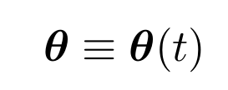
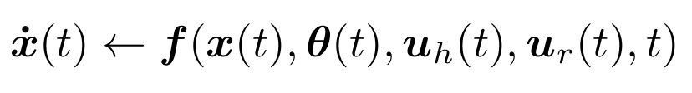
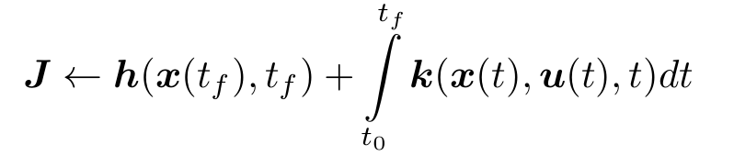
Customization as optimal control
Final Control
Command
Arbitration Parameters
Autonomous Control
Command
Human Control
Command
System dynamics
System state
The exact nature of the cost function and system dynamics is unknown and left indeterminate
Notes:
In our work we formulate customization of assistance levels as an optimization problem. Here we have u_r representing the autonomous control command and u_h denoting the human control command. Beta is the arbitration function that arbitartes between uh and ur to produce a final control command u(t) and is paramterized by theta. Arbitration in this context refers to some scheme by which the human control command and the robot control command can be combined to produce a final control command. This can be a heirarchical scheme or can be a blending based paradigm in which uh and ur belong to the same vector space.
Customization of assistance level can then be formulated as an optimization problem in which a cost function J is minimized with respect to parameters theta(t). Note that the, J is dependent on theta(t) through the system dynamics. However, in our work we do not try to make an attempt to determine the exact nature of the cost function or system dynamics.
Why this framework:
Provide a firm mathematical formulations helps in more rigorous analysis of relevant questions
Inspiration from optimal control being used in explaining motor control.

Slide 6
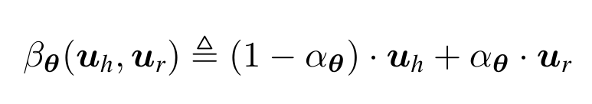

System description
Linear Blending
Blending Factor
Confidence – Estimation of human intent
Blending factor as a parameterized function
of confidence
Velocity alignment
Proximity
Θ = {θ₁, θ₂, θ₃}
α_{θ}
α_{θ}
θ₃
θ₁
θ₂
Confidence c(t)
Confidence c(t)
Notes:
In our specific implementation, the human and robot autonomy signals are combined in using a simple linear blending paradigm, where alpha is the blending factor. Note that in this formulation the parameters only affect the blend factor
We also introduce the notion of confidence. This confidence refers to the system's confidence in its own estimate of human intent. Suppose the user is trying to accomplish a reaching task. For each of the goals present in the scene, at every time step the system tries to compute a confidence measure. The goal with the highest confidence is chosen as the current goal. How one chooses the confidence metric is entirely upto the system designer. Our confidence metric consists of two terms, the first one looks at the alignment of the human and autonomy control commands and the second one deals with the prixmity to a goal.
Therefore, The essential idea is that, if the system is more confidence in its prediction then it will try to assist more, if not it will let the user do whatever he/she wants. Thats is confidence affects the blending factor.
So then the blending factor can be conceived as a parameterized function of confidence and this figure shows the functional dependance of alpha on confidence. The parameter vector theta is 3 dimensional. Theta1 represents the minimum confidence above which the assistance will kick (that alpha is greater than zero) and theta2 together with theta 1 controls how aggressive the assistance will be and lastly theta 3 controls the maximum assistance the system will have to offer. Optimization over the parameters, then essentially amounts to changing the shape of this function

Slide 7
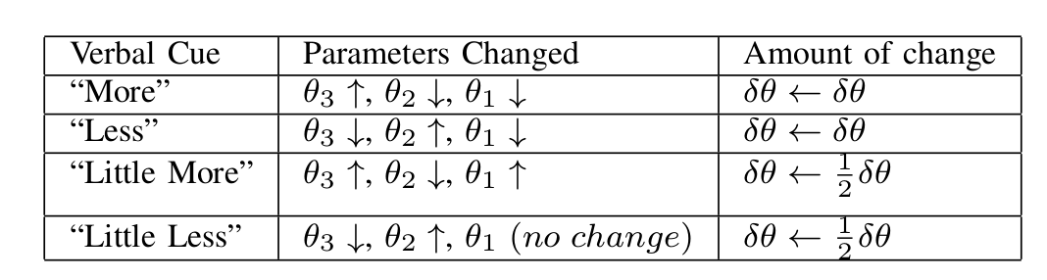
User-driven customization
Exploratory approach (Interactive and iterative)
Verbal cues are mapped to parameter changes
System operator mediates the procedure
Θ = {θ₁, θ₂, θ₃}
α_{θ}
θ₃
θ₁
θ₂
Confidence c(t)
Notes:
Instead of relying on standard optimization techniques which require the specification of cost functions and system dynamics in our work we have devised an interactive and iterative customization scheme in which verbal requests for changes in assistance from the subjects are mapped to parameter changes in a pre-specified manner. That is the human-in-the-loop performs the optimization. This table here show some example mappings. For example, if the verbal request was “more assistance” then that would be mapped to an increase in theta3 and a decrease in theta 1 and theta2.
Talk about less.
That is with this scheme, the user is able to explore the parameter space in a systematic manner

Slide 8
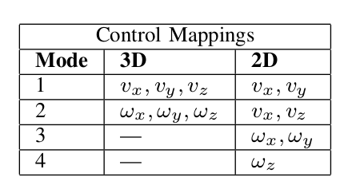
Experimental setup
17 subjects (13 uninjured, 4 spinal cord injured (SCI)), 3 tasks
3 axis joystick - 2 control mappings (2D and 3D)
z
y
y
x
x
Full 6D control requires
mode switches
Notes:
Now I will talk about out experimental setup. The pilot study was done on 17 subjects, 13 uninjured and 4 spinal cord injured. And each subject performed three tasks and we use a 6DOF robotic arm as our platform. The first task was a practice task and data collection was performed on the other two. In the first data collection task the user had perform reaching movements in which the two goal poses were very different. In the second task, the end effector was fitted with a spoon and the user was required to perform a scooping motion.
The control interface used was a 3axis joystick. The control command issued from the joystick is the full 6D cartesian velocity of the end effector. Two different control mappings were used, which we call 2d and 3d. As shown in this table in 2d mapping, each mode controlled at max 2 control dimensions whereas in 3d each mode corresponded to 3 control dimensions.

Slide 9
Experimental setup
17 subjects (13 uninjured, 4 spinal cord injured (SCI)), 3 tasks
3 axis joystick - 2 control mappings (2D and 3D)
2 predefined levels (min and max ), 2 rounds of customization
Kinova MICO - 6DOF robotic arm
Notes:
- Additionally we had two predefined assistance levels called min and max. Prior to each one of the data collection task the user experienced what min and max assistance level and they they customized the assistance levels according to their preference using the scheme presented in the previous slide. Resulting in assistance level 'custom'. Note that custom is always going to be in between min and max. The trials were randomized and data was collected on tel, min, max and custom.
Next we will look at some of the results from the pilot study

Slide 10
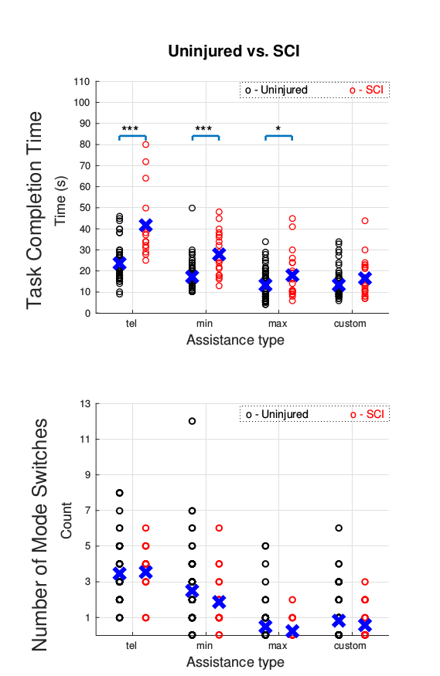
Customization reduces performance differences
Assistance reduced performance differences; no statistical difference in custom
No difference in mode switches
o – Uninjured o - SCI
Notes:
In these plots the x-axis represents the assistance levels, starting with tel, min max and custom. On the y axis, in the top figure we have the task compleition times and the bottom figure its the number of mode switches. And here we are looking at performances between subject groups.
We obseved that assistance helped in reducing the performane differences with respect to task compleition times between the two subject groups and in the custom we were not able to detect any statistical difference between the two subject groups. However no differences were found in the number of mode switches and this is possibly because the number of mode switches depend primarily on the nature of the task and not the state of injury.
We had 17 subjects performing a total 34 rounds of customization. 7 our of the 34 customizations resulted in greater task compleition times than max level (which is guarenteed to be the minimum) and 14 of the 34 customizations had greater number of mode swicthes. This could possibly mean that the users are optimizing for something more than just minimum time or minimum effort cost functions.

Slide 11
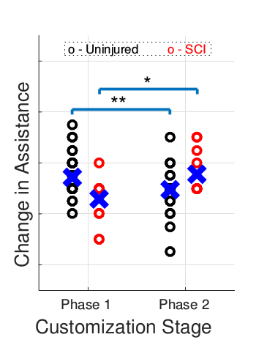
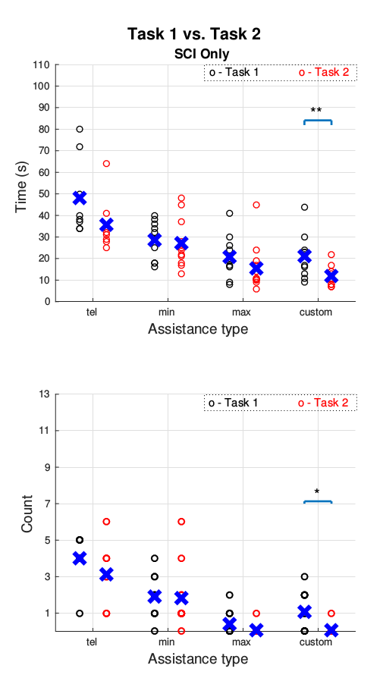
Customization trends
SCI customized for more; Uninjured customized for less (between tasks)
SCI – performance improvement
o – Uninjured o - SCI
o – Task 1 o – Task 2
Notes:
Lets take a look at the customization trends in each of the subject groups between tasks.
SCI customized for more assistance whereas unjinjured customized for less. The effect of these choices are clearly when we look at the performance metrics. For SCI subjects as a result of increased assistance the performance improvement as seen here. Furthermore, statistically significant improvements were not observed in any other assistance level Whereas there was a performance decline for unjinjured subjects.

Slide 12
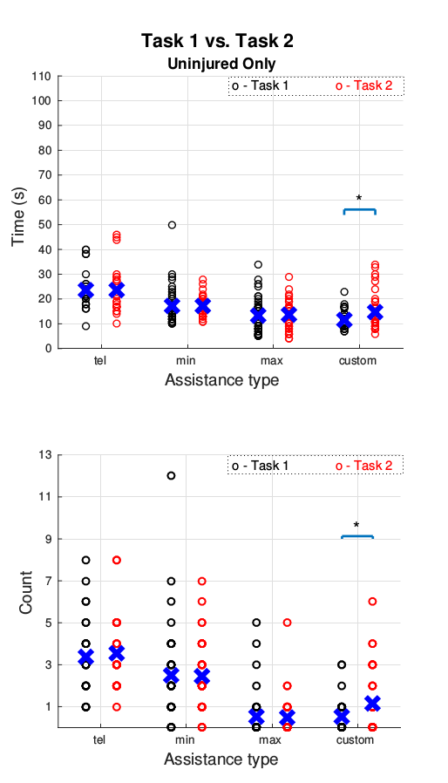
Customization trends
SCI customized for more; Uninjured customized for less (between tasks)
SCI – performance improvement
Uninjured – performance decline
Insight into cost function
  7 of 34 customizations had greater completion times (minimum time)
  14 of 34 customizations had greater number of mode switches (minimum effort)
o – Uninjured o - SCI
o – Task 1 o – Task 2
Notes:
Whereas there was a performance decline for unjinjured subjects.
It is interesting to note that Uninjured subjects opted for lower assistance level despite a decrease in performance level

Slide 13

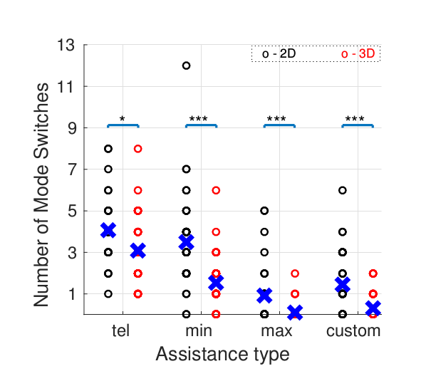
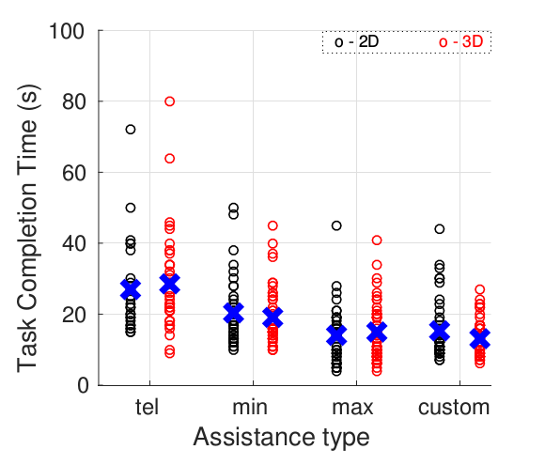
Effect of interface mappings
Mode switches – 2D > 3D
No difference in task completion times between mappings
o – 2D o – 3D
Notes:
Lastly the effect of interface mappings on task performance.
If we take a look at the bottom plot, we see that, the number of mode switches is greater for 2d than 3d. This is not surprising because by definition the 2d mapping operates in 4 modes whereas 3d operates in 2 modes. However, interestingly we did not see any differences in task compleition times between the interface mappings. This can possibly have a simple explanation. In 2d mapping, in every mode, the user is controlling at max 2 control dimensions. The number of options are less and therefore the chances of getting confused are also less and thereby makes it easier to control. So therefore the time lost performing the extra mode switches is compensated by easier control which lets the users make quicker decisions when being in each mode.

Slide 14
Performance video - Teleoperation
Multiple mode switches
High task completion time
Notes:
In this video we have a SCI subject using the 3d mapping paradigm. He starts off in the translational mode. And right here, he performs a mode switch.
And then he performs one more mode switch.
Next we will see the same task but using the max assistance level.

Slide 15
Performance video - Max
Robot policy in full 6D space
No mode switches+reduce task completion time
Notes:
Here we can see that both translation and rotation of the end effector is happening simultaneously as the robot policy is the entire 6 dimensional control space. And there were no mode switches as well. And lastly we will see how customized assistance level works for this subject

Slide 16
Performance video - Custom
User retains more control
Notes:
The translation and rotation is still happening simultaneously but not to a great extent. Still required one mode switch to correct the orientation.

Slide 17
Conclusions
Customization was situated within optimal control
Interactive and iterative customization scheme was developed
Results from pilot study
  Customization reduced performance differences between subject groups
  Between subject groups and control interfaces analysis
  Insight into cost function
Future work – physical interfaces for customization
Notes:
In conclusion, in this work we situated customization of assistance levels in a shared control system within an optimization framework. We also devised an interactive and iterative customization scheme which allowed the human-in-the-loop to perform the customization procedure.
With customization, SCI subjects were able to achieve performances comparable to that of uninjured subjects. Our studies also shed some light on the customization trends between subjects groups and how different control mappings affect performance.
For future work, we are in the process of eliminating the need for a system operator in the customization procedure.. Instead we are developing physical interfaces for customization such as sliders, knobs and buttons which will then enable the user to perform in a more direct manner and allowing for exploration in the continuous parameter space.
That's all I have for today, Thank you very much and I am happy to take any questions

Slide 18



Thank you!
This work was supported by by the National Institute of Biomedical Imaging and Bioengineering and the National Institute of Child
Health and Human Development of the National Institutes of Health under award number R01EB019335

